Slide 1

The audit process

Slide 2
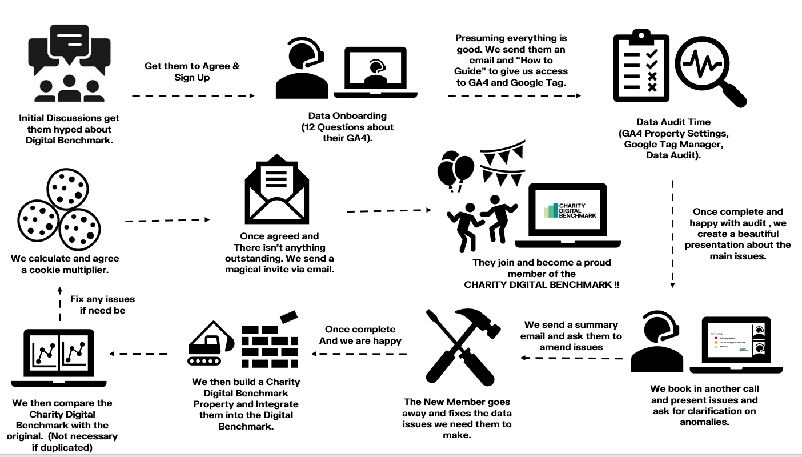

Slide 3
The audit process: overview
Whilst the audit process is a great selling point of joining the CDB, the faster we get users onboarded and the more we grow, the stronger our statistics and selling power is.
The audit process is a free benefit of using the CDB. It is intentionally detail orientated to ensure we can help where we can and ensure top quality data for us and our members.
However, we should try and streamline where possible.

Slide 4
Streamlining: Delays
As it stands, we have multiple touchpoints along the audit process where we communicate with clients.
These can be planned, communication issues or access issues for the most part.
We can plan to reduce these.

Slide 5
Mistakes
One example of a mistake I made which prolonged the process:
sending the data onboarding questions ahead of time (requested but I should have simplified them more)
and not stressing that the initial data session does not require all the answers.
This delayed Lymphoma action by 3 weeks as they went to discuss with their web agency. Nothing useful was learned in the interim

Slide 6
Access
We are constantly having to get in contact with members RE access.
Common mistakes are giving us access at the property level instead of account level or not setting the right permissions
Access in data call – would give understanding of their level of ga4 knowledge

